Slide 1
Closed loop control systems

Slide 2
Acquiring knowledge of control systems

Slide 3
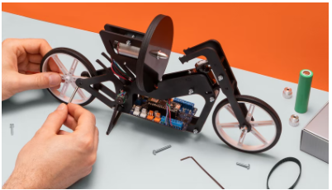
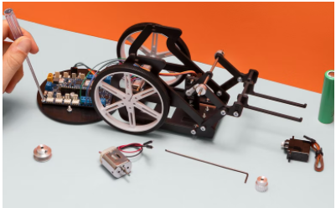
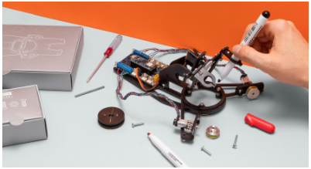
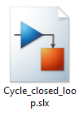
Introduction
Competencies
Closed loop control systems
Learning with Arduino Engineering Kits…
SELF-BALANCING MOTORCYCLE
WEBCAM CONTROLLED ROVER
DRAWING ROBOT
Required files:

Slide 4
Fundamentals
1

Slide 5
Control systems
1.1

Slide 6
Control systems
A control system is a set of devices responsible for managing, ordering, directing or regulating the behavior of another system, in order to reduce the chances of failure and obtain the desired results.
There are two common classes of control systems, open loop systems and closed loop systems:
In open loop control systems the output does not intervene in the control action; while in those of closed loop if it is going to be required to know the output to exercise control of the system.
A closed loop system is also called a feedback control system.
In general, industrial control systems are used for industrial production processes to control equipment or machines.

Slide 7
Classification of control systems
1.2

Slide 8
Open loop control system
It is that system in which the output has no effect on the control system, this means that there is no feedback of that output to the controller so that it can adjust the control action.
Examples:
A common "automatic" washing machine, since it performs the washing cycles based on a time base, but does not measure the degree of cleanliness of the clothes, which would be the output to consider. When making a toast, the time that we suppose is placed enough for the bread to come out with the degree of toast we want, but the toaster can not decide if it is already sufficiently toasted or not.
These systems are characterized by:
Be simple and easy to maintain.
Output does not compare to input.
Being affected by disturbances.
Accuracy depends on previous system calibration.

Slide 9
Open loop control system
Entrance
Exit
CONTROL
PROCESS
Microwave
Time
Hot food?
CONTROL
PROCESS

Slide 10
Closed loop control system
They are the systems in which the control action is a function of the output signal; that is, in closed-loop control systems or control systems with feedback, the output to be controlled is fed back to compare it with the input (desired value). Comparing the input and output generates an error that the controller receives to decide the action to take on the process, in order to reduce said error and therefore, bring the output of the system to the desired value.
Examples:
An example of a closed loop control system would be heating with environmental thermoregulation.
Cruise control of a vehicle, where a speed is specified and the cruise control system performs the calculations and actions necessary to achieve and maintain the indicated speed.
Its characteristics are:
Be complex and broad in number of parameters.
The output is compared with the input and to perform system control.
Be more stable to internal disturbances and variations.

Slide 11
Sistema de control de lazo cerrado
Entrance
Exit
+
-
CONTROL
PROCESS
Retroalimentación
Cruise control
Speed indicated
Desired speed
+
-
CONTROL
PROCESS
Feedback

Slide 12
Closed loop control systems
2

Slide 13
System Components
2.1

Slide 14
Feedback
Feedback is the process by which the information of the output of a system is analyzed and thus be able to modify or not the input. Modifying the Input allows you to adjust the output to a desired value with an acceptable error. This is the mechanism that makes a closed loop control system so named.
These systems require two types of artifacts:
Controller
Sensors or transducers Actuators

Slide 15
The controller
In industry, controllers are used whose function is to compare the measured process variable of a physical cause with an input reference value, to determine the deviation and is to produce a control signal that reduces the error to a value approximate to zero.
The way in which the controller executes the control signal is called a control action. The controller detects the error signal, usually given at a very low power level, and amplifies it to a high enough level. The output of a controller feeds an actuator. They are classified according to their control action:
Two-position or on-off action:
In this type of closed-loop control, the control action can take one of two positions in relation to the error, open or closed, with a high impedance..
Proportional action:
The proportional control system is based on establishing a continuous linear relationship between the value of the controlled variable and the position of the final control element.

Slide 16
The controller
Integral control:
Integral control bases its operation on activating a control element at a constant speed, until the deviation is eliminated. The drive speed shall be proportional to the error of the existing system.
Proportional-integral action:
Comprehensive Proportional Control decreases rise time, increases over-impulse and stabilization time, and has the effect of eliminating steady-state error but will worsen the compromising response.
Proportional-derivative action:
In the derived regulation, the control action will be proportional to the rate of change of the controlled variable. Thus, the final control element will suffer a greater or lesser travel depending on the speed of change of the system error.
Proportional-integral-derivative action:
It is a feedback control mechanism that employs the sum of proportional, integral and derivative control actions, for this reason this control is the most used in the control of industrial processes.

Slide 17
Sensors
Sensors are devices that allow to determine values of a certain magnitude, that is, they detect external or internal indicators, whether light intensity, sound, ambient temperature, presence of people, water level, etc.
Sensors for manufacturing interest can be classified into:
Mechanical sensors: to measure quantities such as position, speed, mass, pressure, force, vibration.
Electrical sensors: to measure voltage, current and electrical charges. Magnetic sensors: to measure field, flux and magnetic permeability. Thermal sensors: to measure temperature, flow, conductivity and specific heat

Slide 18
Actuators
An actuator is a device capable of transforming an energy into the activation of a process in order to generate an effect on an automated process. It receives the command from a regulator or controller and based on it generates the command to activate a final control element.
Actuators can be classified as follows:
Electronic Hydraulic
Tyres
Electrical
And the most common actuators can be:
Pneumatic or hydraulic cylinders: they perform linear movements. Pneumatic or hydraulic motors: they perform rotational movements by means of hydraulic or pneumatic energy. Valves: there are direct control, motorized, electro pneumatic. They regulate the flow of gases and liquids. Heating resistors: they are used for heating. Electric motors: the most used are induction, continuous, brushless and step by step. Compressor pumps and fans: usually driven by electric induction motors

Slide 19
Case in practice
3
Stability control

Slide 20
Motorcycle stability control
3.1

Slide 21
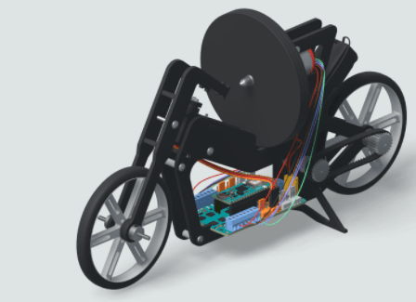

Self-balancing Motorcycle
The self-balancing motorcycle consists of a two-wheeled robot that can balance and move with a rotating disc or flywheel.

Slide 22
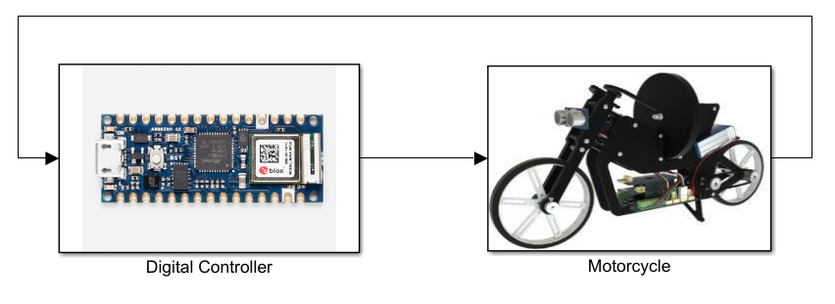
Closed loop-based control for motorcycle stability
Representation of the controller block and plant (motorcycle) based on closed loop systems

Slide 23
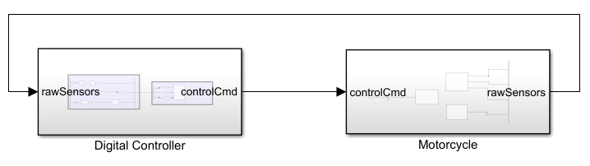
Closed loop-based control for motorcycle stability
The controller requires (input) of data captured by the sensors (output) to be able to perform the necessary calculations (output) and maneuver (input) the inertia system that will keep the motorcycle in balance. This complete cycle of reading, processing and transferring information is carried out with a stipulated optimal frequency.

Slide 24
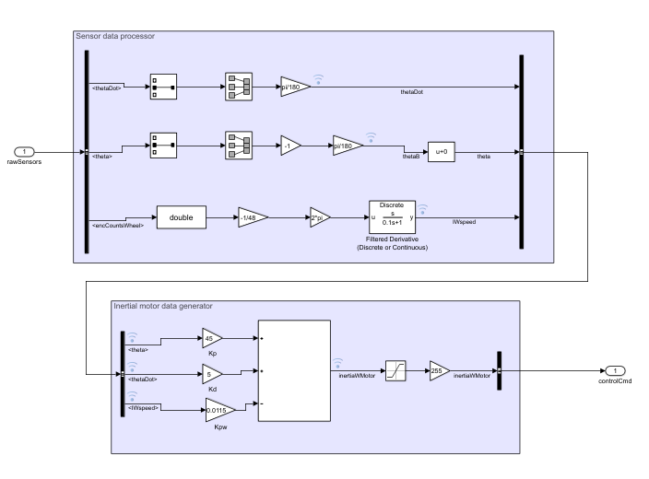
Closed loop-based control for motorcycle stability
The controller subsystem:
processes inertial sensor data generates an output using a proportional-derivative control

Slide 25
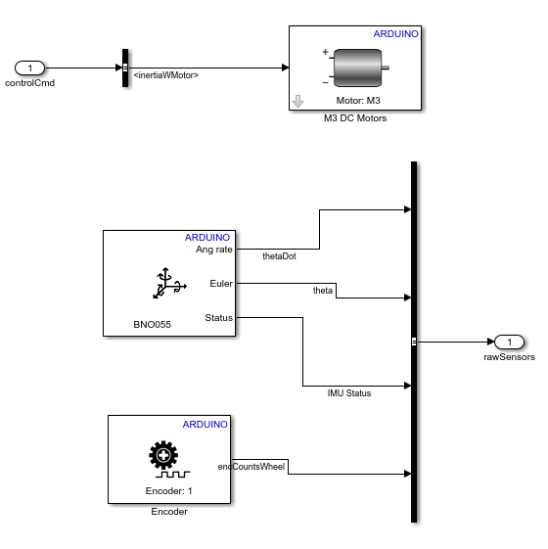
Closed loop-based control for motorcycle stability
The plant or motorcycle subsystem:
receives information from the controller and maneuvers the rotation of the motor the inertial sensor obtains new information with which to restart the control cycle

Slide 26
Working with MATLAB & Simulink
3.2

Slide 27
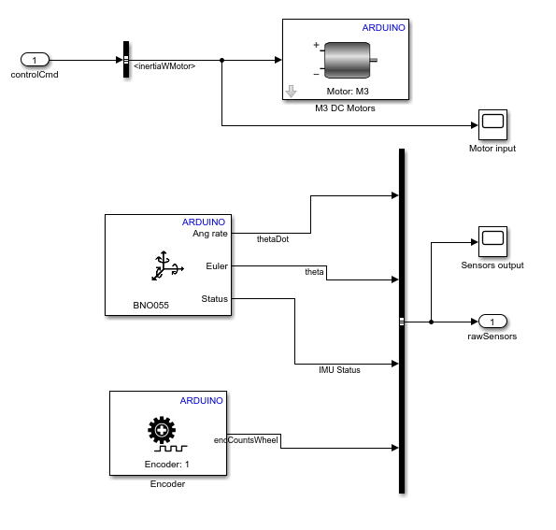


Analysis of control inputs and outputs
Exercise proposal:
It uses the “Cycle closed loop” model as a base and incorporates signal viewers or “Scopes” at the inputs and outputs of the different elements linked to the control system.
Compile the new model and upload it to your Arduino Engineering Kit.
The model will allow you to make an exhaustive analysis of the signals produced by the elements external to the control subsystem.

Slide 28
Eskerrik asko
Muchas gracias
Thank you
Loramendi, 4. Apartado 23
20500 Arrasate – Mondragon
T. 943 71 21 85
info@mondragon.edu

